Slide 1
Phone Application UI design ideas
Ben James

Slide 2
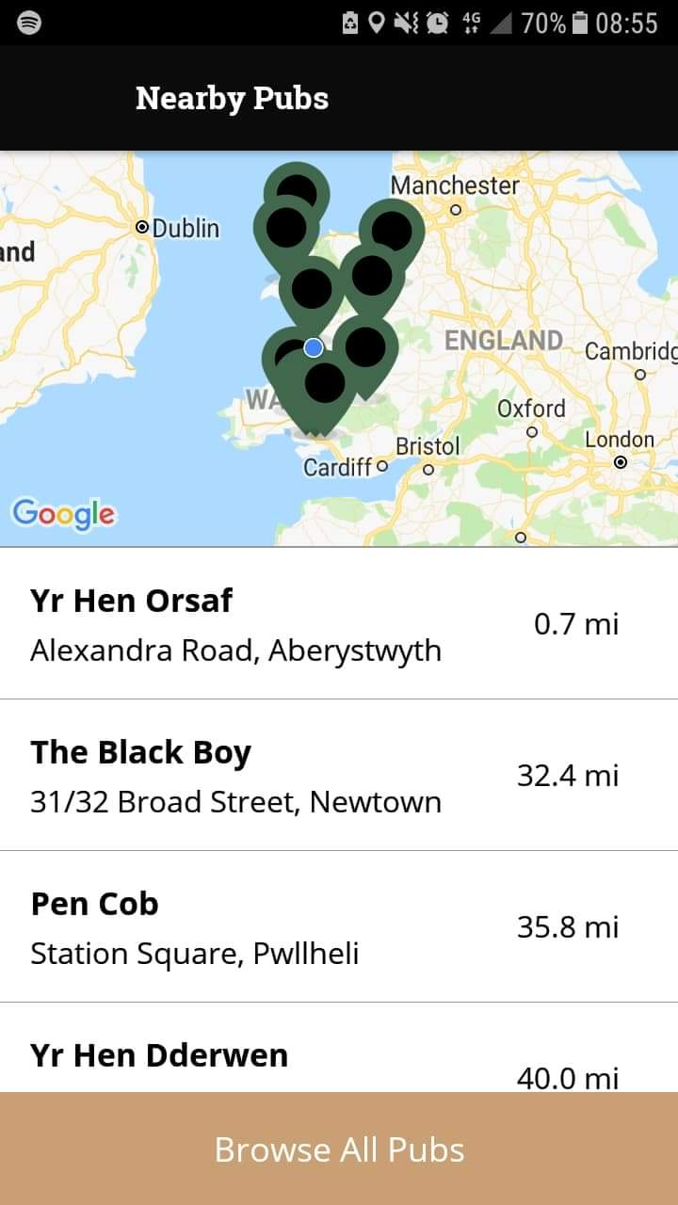
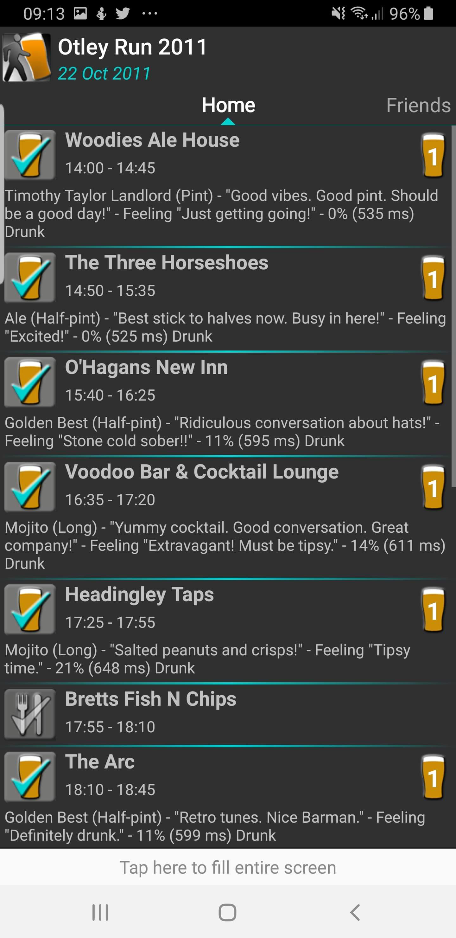
Examples that I got inspiration from
Wetherspoons application
Barathon

Slide 3
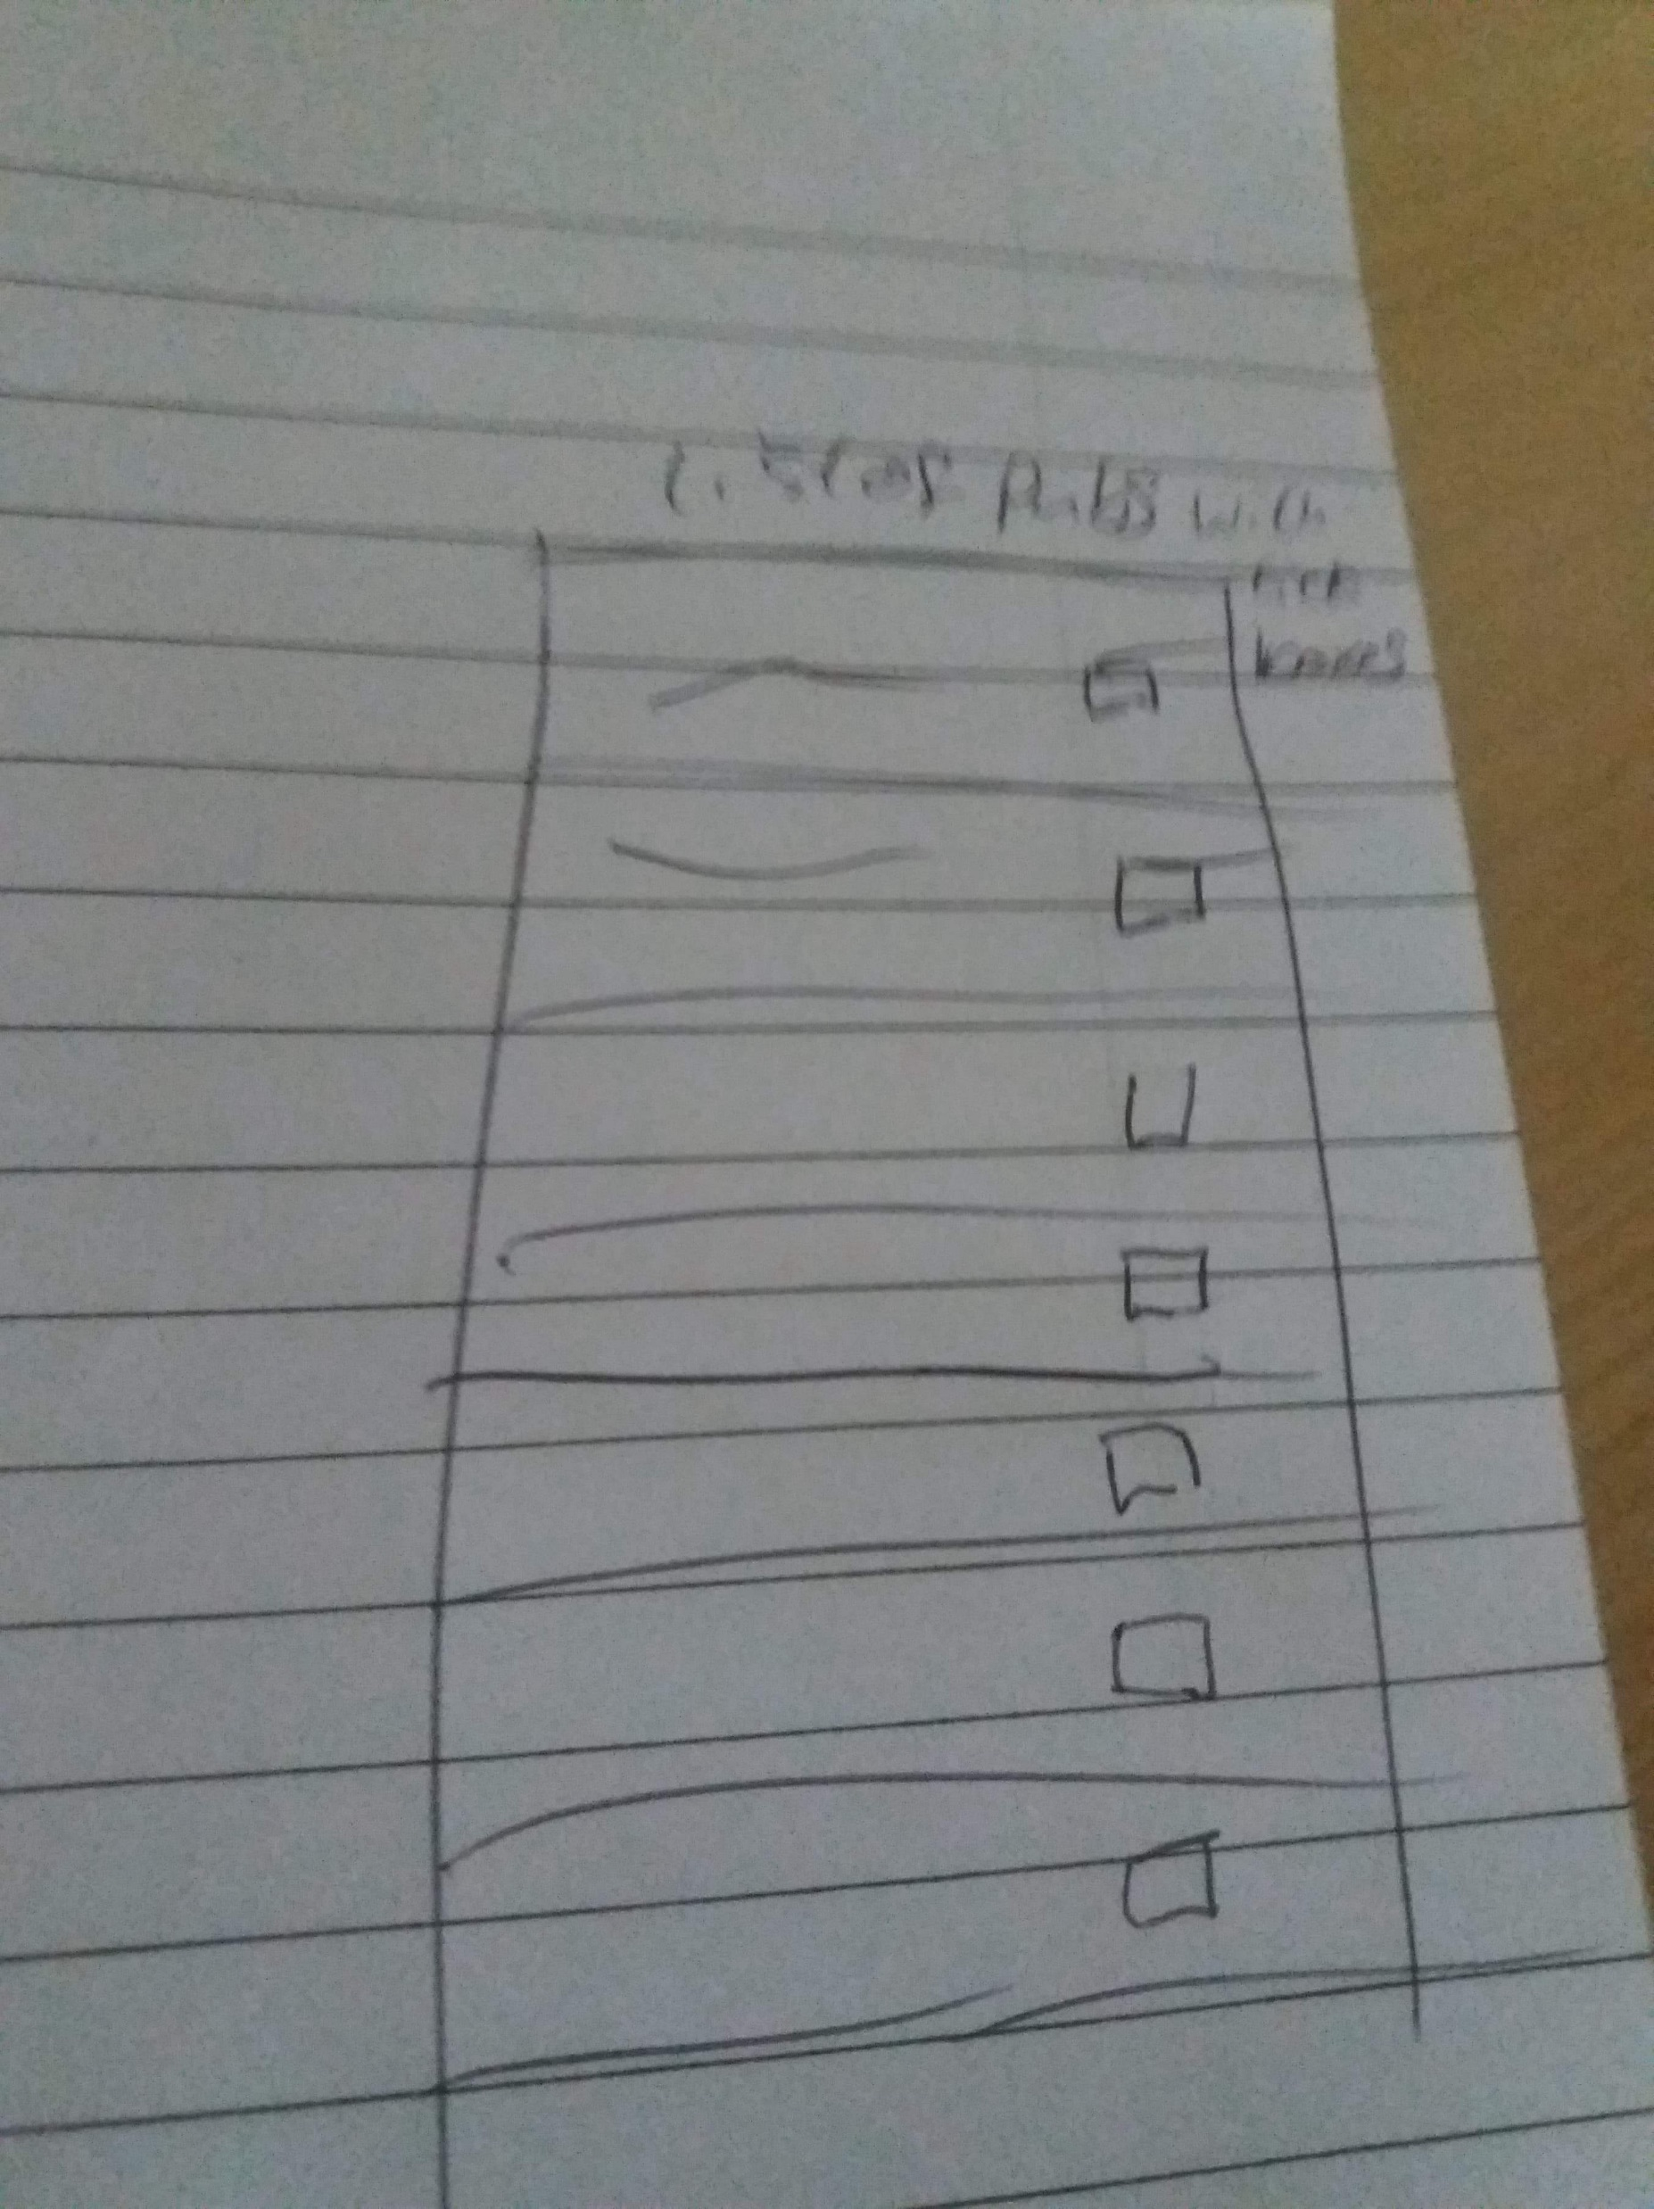
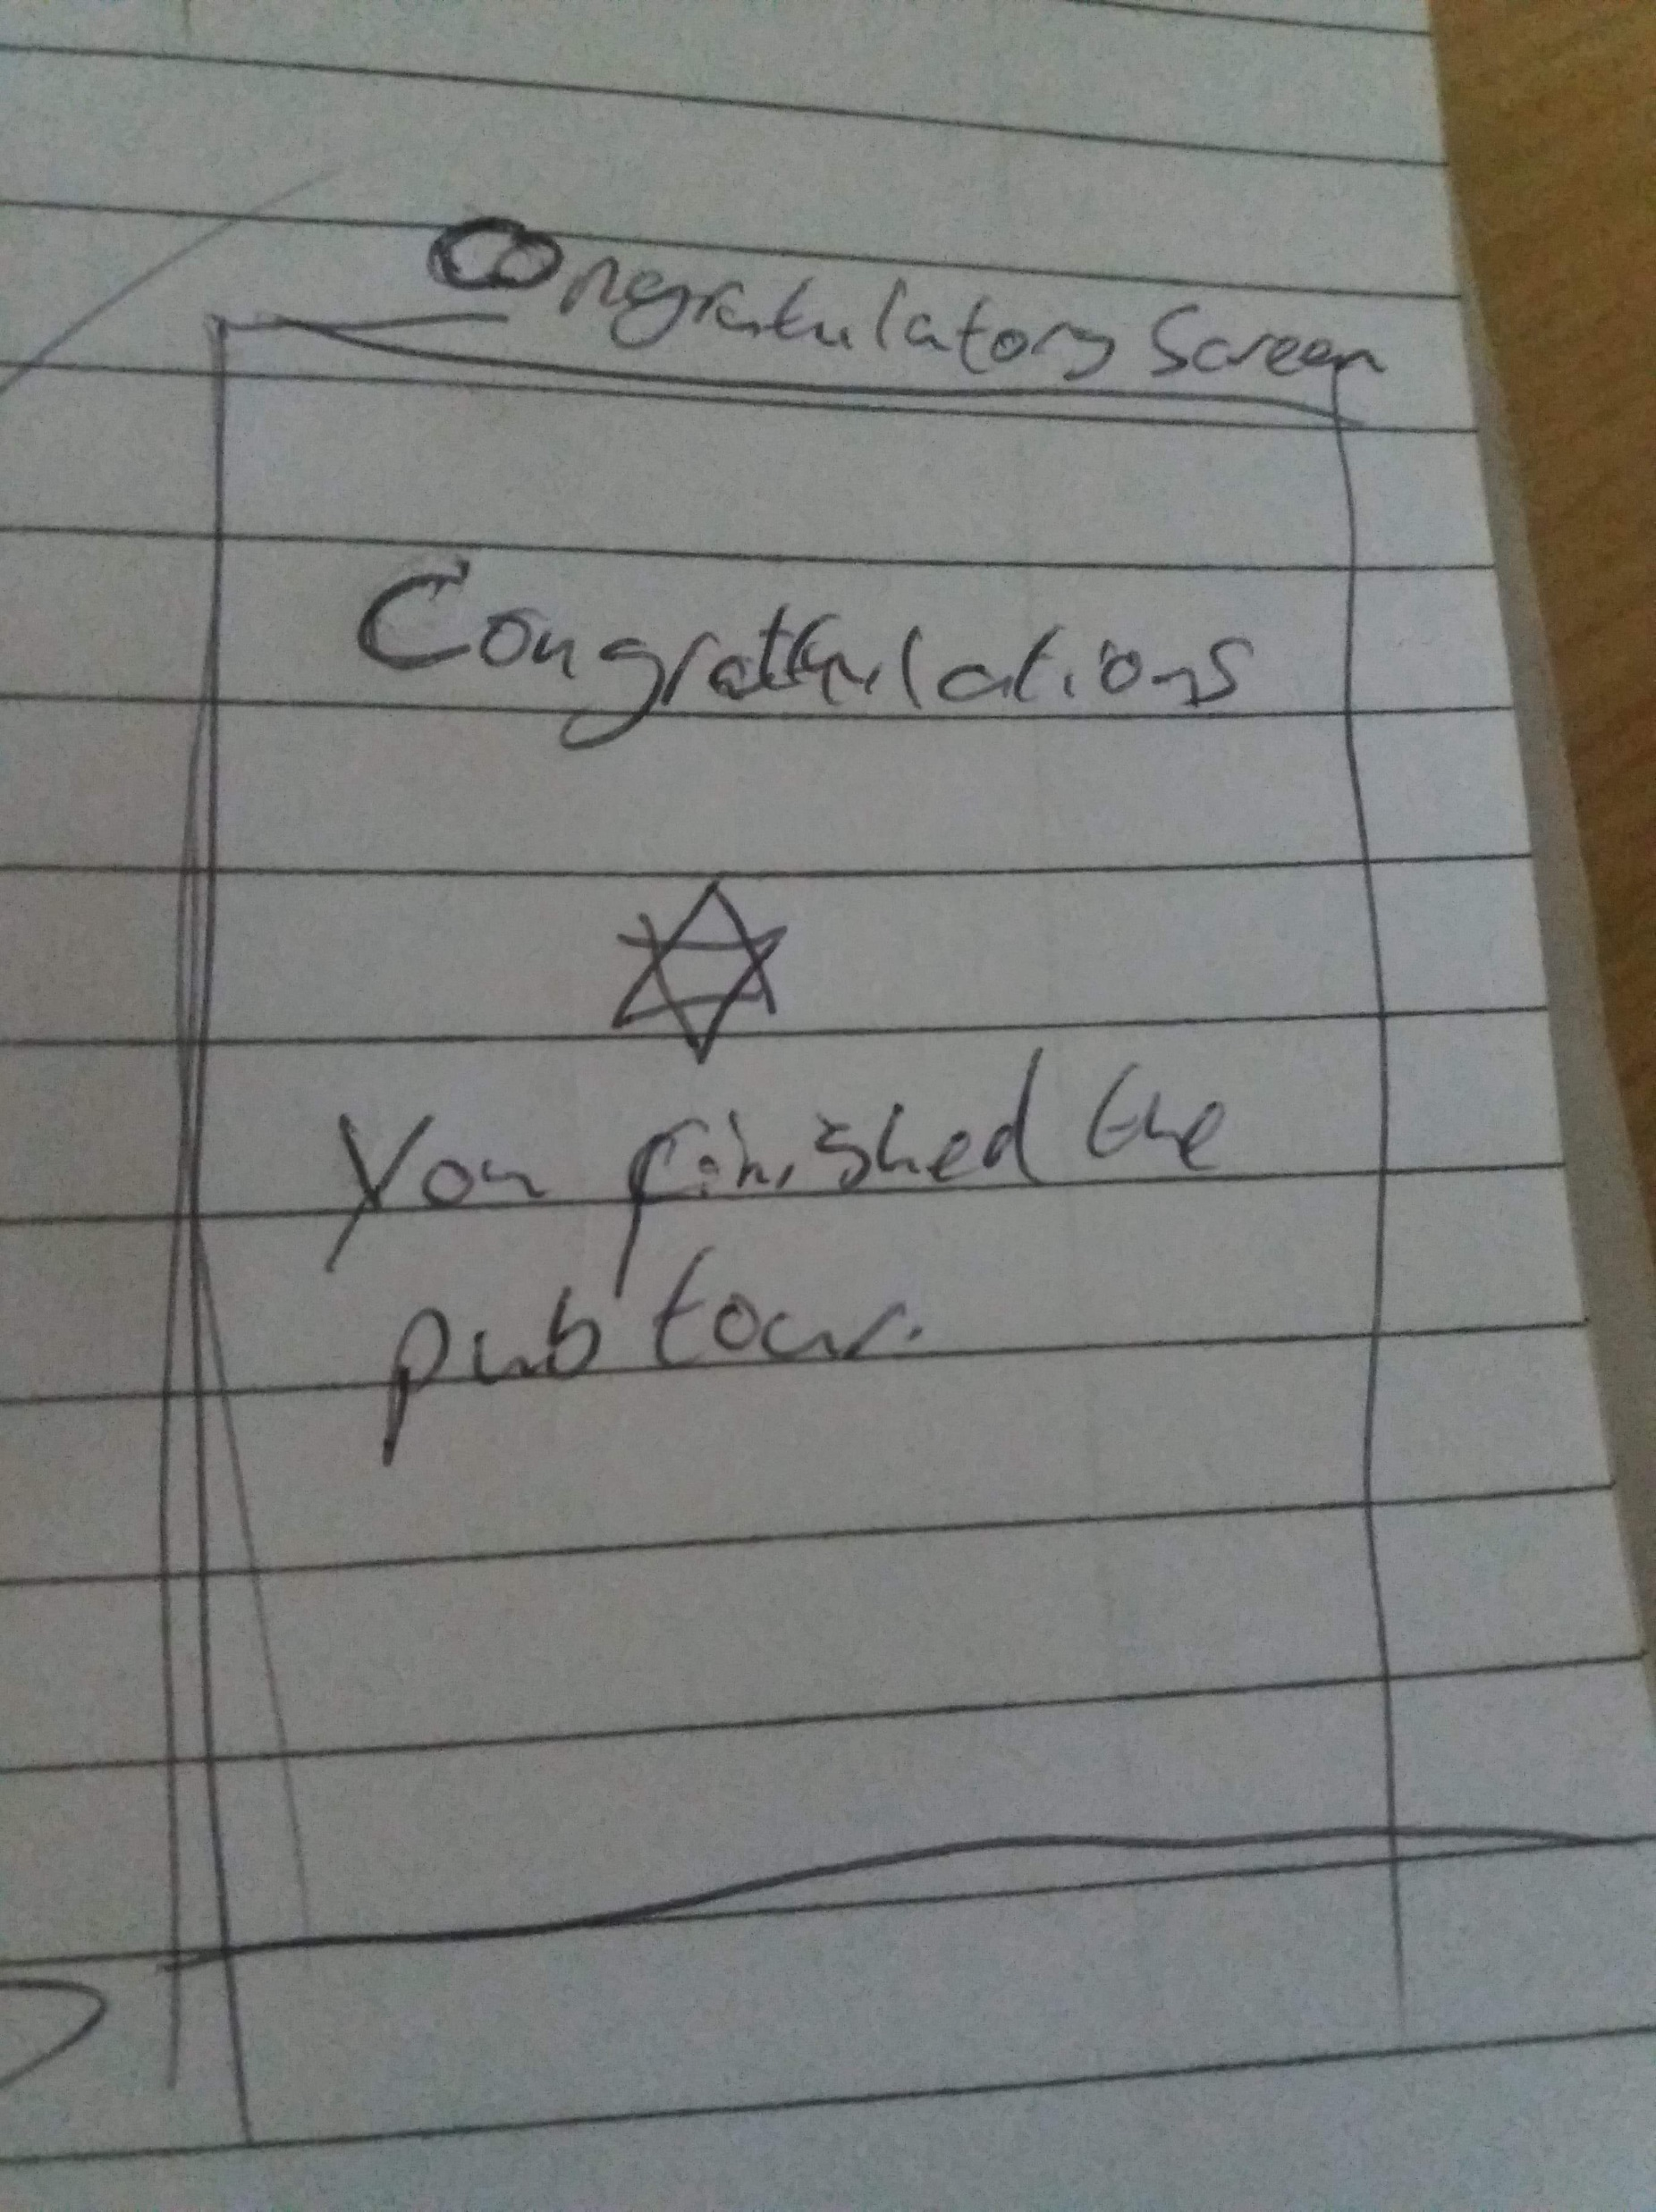
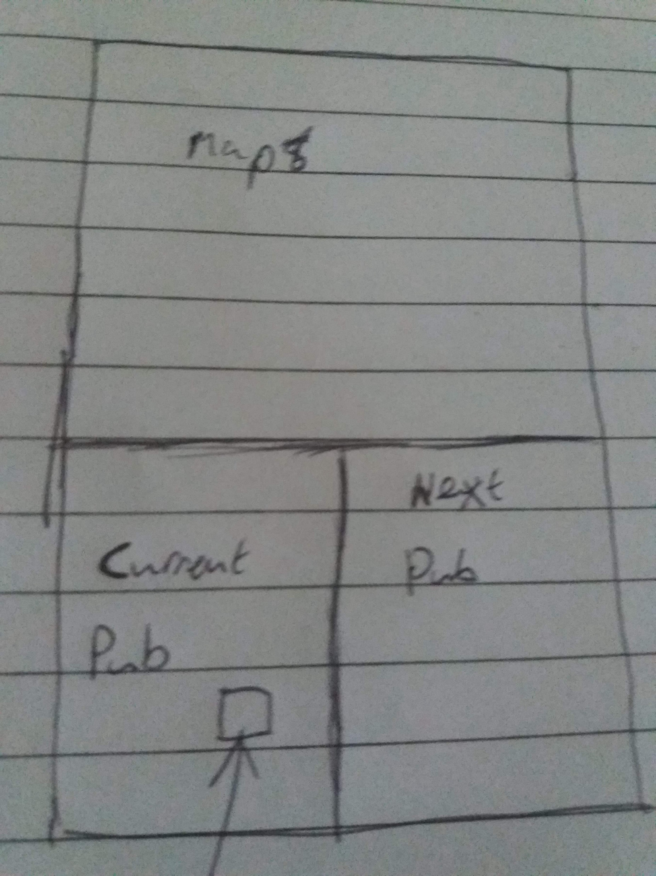
Some drawn up designs taking ideas from example

Slide 4
Digital versions of the UI Design

Slide 5
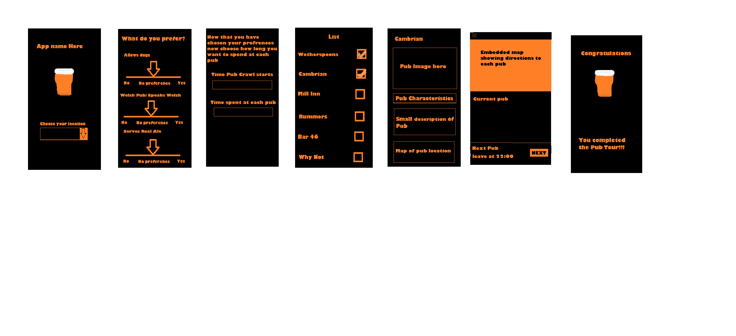
Start up screen and characteristics screen

Slide 6
Timing Pop up and List of pubs

Slide 7

Pub profile page and the main app page

Slide 8
Congratulatory Screen

